Slide 1
Lawn Buddy
“The cutting hedge technology”
Milestone #1: AI Venture Concept Customer Discovery
Gasser Ahmed
MGT 5824
6/12/2023

Slide 2

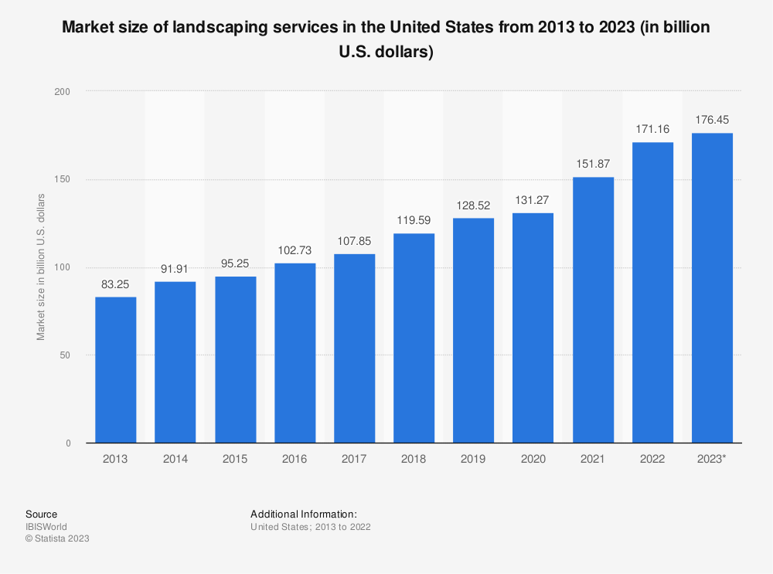
Identification of Target Customer Segment Criteria: Market Size and Potential Growth
The lawn mowing market has shown consistent growth in market size, increasing from 83.25 billion in 2013 to 176 billion in 2023, indicating a positive and upward trend.
Recent years have seen accelerated growth in the market, with the market size expanding significantly from 119 billion in 2018 to 176 billion in 2023, indicating a period of rapid expansion and heightened demand.
The data indicates a favorable market environment for the lawn mowing industry, with sustained growth rates and an expanding market size, suggesting potential opportunities for businesses to capitalize on the increasing demand for lawn care services.

Slide 3
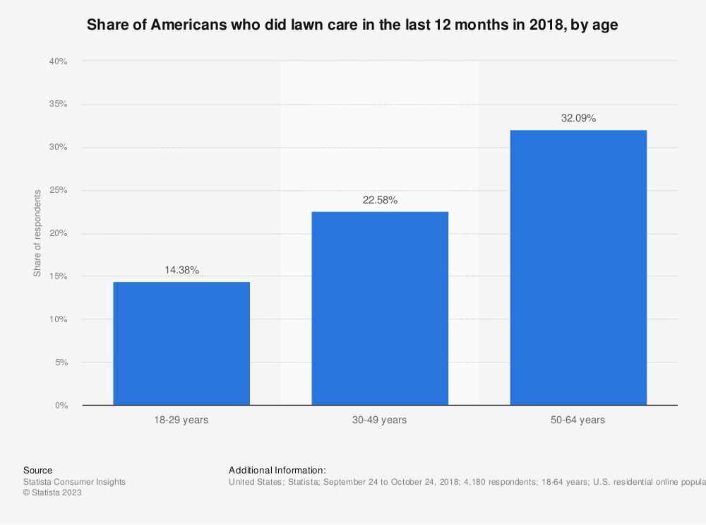
Identification of Target Customer Segment Criteria: Age
The age group of 50-64 years represents the largest share of respondents at 32.09%. This indicates that middle-aged individuals are the most prominent demographic interested or engaged in lawn mowing activities.
The 30-49 years age group follows closely behind with a share of 22.58% of respondents. This suggests that individuals in their prime working years also have a significant presence in the lawn mowing market.
The 18-29 years age group comprises a smaller share of respondents at 14.38%. This indicates that younger individuals have a relatively lower level of interest or involvement in lawn mowing activities compared to other age groups surveyed.
The data highlights the importance of targeting middle-aged and older individuals as the primary customer segment.

Slide 4
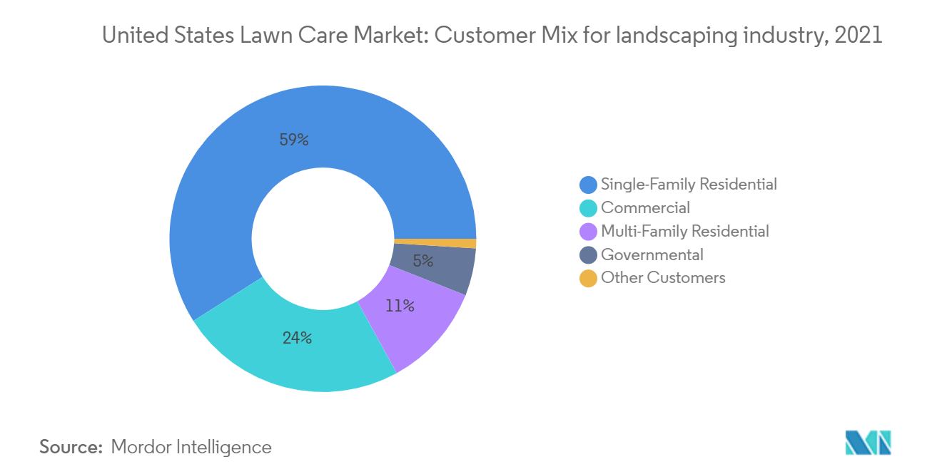
Identification of Target Customer Segment Criteria: Customer Type
Single-family residential customers represent the largest customer segment, accounting for 59% of the total customer base. This suggests that homeowners who own single-family properties are the primary consumers of lawn mowing services.
The commercial segment comprises 24% of the customer base, indicating that businesses and commercial properties are significant customers for lawn mowing services. This includes retail stores, offices, and other non-residential establishments.
The multi-family residential segment represents 11% of the customer base, such as property owners or managers of multi-unit residential buildings
The governmental segment accounts for 5% of the customer base, suggesting that government entities and institutions, such as public parks or government-owned properties, require lawn mowing services as well.

Slide 5
Identification of Target Customer Segment Most Suitable Customer Segment
The combination of the market size and potential growth, along with the age distribution and customer type data, underscores the suitability of middle-aged and older individuals within the single-family residential customer segment as the most suitable target for a lawn mowing business for the following reasons:
Market Size and Potential Growth: The market size for lawn mowing has consistently grown over the years, indicating a robust industry. From 2013 (83.25 billion) to 2023 (176 billion), the market size has nearly doubled, demonstrating a significant growth potential. Single-family residential customers, representing the largest customer segment have contributed to this growth and are likely to continue driving market expansion.
Age Distribution: The data on age distribution shows that the 50-64 years age group accounts for the highest share of respondents. This aligns with the middle-aged and older demographic targeted within the single-family residential customer segment. The higher proportion of individuals in this age group indicates a larger pool of potential customers who are likely to require lawn mowing services.
Customer Type Distribution: Among the customer types, single-family residential customers make up the majority at 59%. This data further emphasizes the significance of targeting this customer segment. By focusing on single-family residential customers, Lawn Buddy can tap into the largest customer base, ensuring a steady flow of work and revenue. Additionally, the 24% share of commercial customers can serve as an additional revenue stream, but the dominant presence of single-family residential customers highlights their suitability as the primary target.
(Additional justifications are included below in the Notes section)
Notes:
Stability and Consistency: Middle-aged and older individuals who own single-family residential properties tend to have a stable lifestyle and settled living arrangements. They are more likely to stay in their homes for an extended period, leading to consistent and recurring lawn care needs. This stability provides a reliable customer base for a lawn mowing business, ensuring a steady flow of work and revenue.
Financial Capability: Middle-aged and older individuals often have higher income levels and greater financial stability compared to younger demographics. This financial capability allows them to invest in professional lawn care services and prioritize the upkeep of their property's appearance. As a result, they are more willing to pay for quality lawn mowing services, offering the potential for higher-profit margins for the business.
Experience and Trust: Middle-aged and older individuals generally value experience, reliability, and trustworthiness when choosing service providers. By targeting this age group, a lawn mowing business can leverage its expertise, reputation, and track record to establish trust and credibility. Building trust with customers in this segment can lead to long-term relationships, repeat business, and positive word-of-mouth referrals.
Growth Potential: The middle-aged and older population is expanding in many regions, presenting growth opportunities for businesses targeting this demographic. As this segment continues to grow, the demand for lawn mowing services from single-family residential customers in this age group is likely to increase as well. By establishing a strong presence and reputation within this target segment, Lawn Buddy can position itself for long-term growth and sustainability.

Slide 6
Identification of Key Customer Problems
Notes:
Tasks:
1. Develop a primary data strategy: To build the primary dataset you have three options — you only need to pick one:
A) customer interviews using semi-structured interviews comprised of questions aimed at uncovering the challenges and needs within the target customer segment. Target: Minimum of 6 interviews.
B) target segment survey comprised of questions aimed at uncovering the challenges and needs within the target customer segment. Target: Minimum of 30 survey responses.
C) Natural language processing using AI tools such as sentiment analysis, latent Dirichlet allocation or other topic modeling tools. To build your dataset, you are welcome to use web scraping tools or find a dataset online with data from your customer segment. Target: Minimum is contingent upon particular analytics strategy. If you would to work on this method, please touch base with Dr. T. to discuss your plan in more detail.
Rubric
1. Quality and effectiveness of the chosen primary data strategy (10 points)
2. Implementation of the chosen strategy - quality of interviews, surveys, or NLP strategy and data collected (10 points)
3. Thoroughness in identifying key customer problems based on primary data collected (10 points)

Slide 7
Analysis of Customer Discovery Data
Notes:
Tasks:
1. Organize and structure the data for analysis.
2. Perform qualitative analysis, statistical analysis, or machine learning algorithms to extract patterns, trends, or insights from the data.
3. Interpret the analysis results in the context of the customer problems.
Rubric
1. Organization and structuring of the data for analysis (10 points)
2. Appropriateness and execution of analysis methods used - qualitative, statistical, or machine learning (10 points)
3. Insightfulness of the interpretation of analysis results (10 points)

Slide 9



AI Venture Concept Overview
Startup company operating a lawn service platform
Customers input information about their lawn
Customers schedule and confirm lawn service appointment
Lawn Buddy
Notes:
I am building an AI venture concept for [pause][click] a lawn service startup company called [pause][click] Lawn Buddy [pause] that allows [click] lawn owners to input information about their lawn [pause] to help determining the type of service the lawn needs [pause][click] then customers will be able to schedule and confirm their lawn service appointment[pause]

Slide 10




The "Theory“: Common Beliefs
Time-Saving
Expertise and Professionalism
Consistency and Regularity
Equipment and Tools
Notes:
Common beliefs associated with lawn mowing services include [click][pause] expertise and professionalism where many people believe that hiring a lawn mowing service [pause]ensures that professionals with expertise in lawn care [pause] will handle the task effectively and efficiently [pause] another belief is that [pause] hiring a lawn mowing service [click] saves time especially for people having busy lives and not having the time or energy [pause] to dedicate to regular lawn maintenance [pause] Lawn mowing services are also often believed to have access to [click] the proper equipment and tools required for efficient and high-quality lawn care. [pause] lastly lawn mowing services are expected to provide consistent and regular maintenance schedules [pause] which is believed to promote the health and appearance of the lawn

Slide 11



The "Theory“: Uncommon Beliefs
Spiritual Benefits
Astrological Considerations
Ecological Harmony
Notes:
One of the uncommon beliefs associated with lawn mowing services [pause] is that some people believe that the act of mowing the lawn [click][pause] can create positive energy flow or remove negative energies from the environment. [pause] Some individuals also may believe that mowing the lawn during [click] specific lunar phases can yield better results in terms of growth, health, or overall energy balance [pause] lastly [pause] some individuals may hire lawn mowing services [click] that use eco-friendly practices [pause] to minimize noise, air pollution, or harm to beneficial insects and wildlife

Slide 12

Core Problem
Meeting the Expectations of the Homeowner
Notes:
The core problem associated with lawn mowing services is [click]"Meeting the Expectations of the Homeowner.“ [pause] Failure to meet these expectations can lead to frustration and a breakdown in the client-provider relationship.[pause] Therefore, addressing the core problem involves understanding and effectively fulfilling the specific needs and desires of the homeowner in terms of lawn mowing services.

Slide 13



Subproblems
Tasks must be performed properly at the right time
Scheduling and dispatching landscapers on time with the right equipment
Green industry regulations at state and municipality levels
Keeping the equipment safe and in a ready-to-operate condition
Notes:
lawn buddy however faces few subproblems [pause] for instance [pause] landscape maintenance [pause][click]involves multiple tasks [pause] that must be performed properly at the right time[pause] to avoid losing the advantage of natural process [pause][click]In addition[pause] scheduling and dispatching landscapers on time with the right equipment makes a big difference to operations and profitability [pause]Also [pause] since the business is seasonal[click] , keeping the equipment safe and in a ready-to-operate condition when the crew needs them at the job site [pause] is a challenge [pause] and requires proper usage and maintenance on a routine basis [pause] Lastly[pause][click] Green industry regulations [pause] whether it is related to the use of pesticides and fertilizers or the equipment and pollution levels [pause] is a big challenge for Lawn Buddy

Slide 14



Actions: Run Experiments
Customer Feedback Experiment
Service Timing Experiment
Equipment and Technology Experiment
Notes:
One of the experiments we need to run to improve our operations is to [click] develop a systematic approach to collecting and analyzing customer feedback to identify areas for improvement, and tailor our services accordingly [pause] In addition [pause] we need [click] to test different scheduling options to determine the optimal timing for providing lawn mowing services [pause] to identify the preferred time slots that align with customers’ needs and preferences. [pause] lastly [pause] we need to test and evaluate the use of new equipment or technologies that could improve efficiency and quality that will streamline operations and enhance customer experience accordingly

Slide 15


Actions: Shop for Resources
Lawn Mowing Equipment
Insurance and Licensing
Training and Education
Notes:
One of the resources that Lawn Buddy needs [pause] is to [click] invest in high-quality lawn mowing equipment [pause] in addition to [click] having the necessary insurance coverage [pause] and obtaining any required licenses or permits needed [pause] to operate lawn mowing services legally in the area.[pause]lastly[pause] we will need to allocate resources [click] for ongoing training and education[pause] to stay updated on the latest lawn care practices, safety guidelines, and government regulations

Slide 16



Actions: Search for Solutions
Mobile Apps and Online Platforms
Performance Tracking and Analytics Tools
Online Marketing and Advertising Solutions
Notes:
In order to enhance Lawn Buddy, we need to [pause][click] explore mobile apps and online platforms that can enhance customer experience and provide a user-friendly interface [pause] for managing service requests and payments [pause] we will also need to [pause][click] implement performance tracking and analytics tools [pause] to monitor key metrics that can provide insights into our business's performance [pause] and help us make data-driven decisions [pause] lastly [pause] we need to [click] search for digital marketing solutions that can help us improve our online presence [pause] reach a wider audience [pause] and attract potential customers [pause][pause] Thank you for watching!

